Slide 1
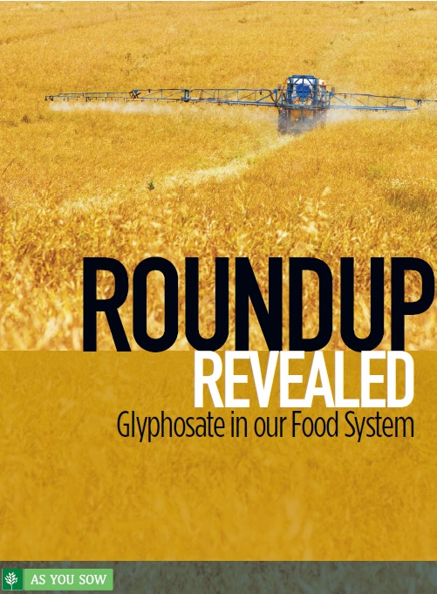

Roundup Revealed: Glyphosate in our Food System
Lead author: Austin Wilson
Contributing author: Danielle Fugere
Download the report at http://go.asyousow.org/
RoundupRevealed

Slide 2
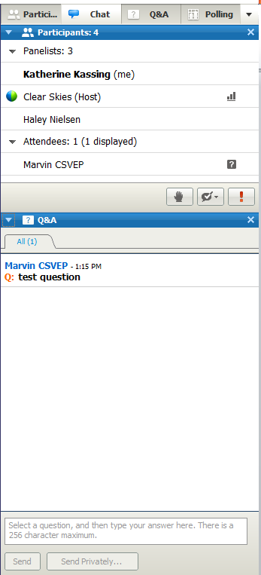
General Information
For technical support call 510-735-8157 or email tarhamsadr@asyousow.org
Use the Q&A window to send us your questions
Webinar recording and report will be available for download after the webinar asyousow.org
Q&A Window

Slide 4




Moderator & Featured Speakers
Danielle Fugere Report Contributing Author and President and Chief Counsel at As You Sow
Austin Wilson
Report Author and Environmental Health Program Manager at As You Sow
Bill Freese
Science Policy Analyst
Center for Food Safety
Dr. Charles Benbrook
Visiting Professor, Newcastle University and Benbrook Consulting Services

Slide 5
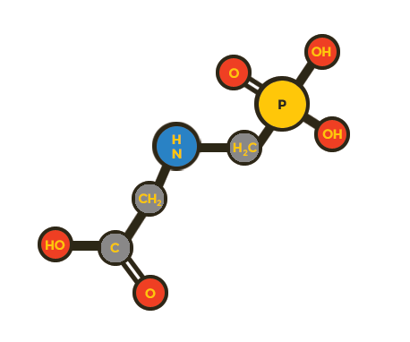
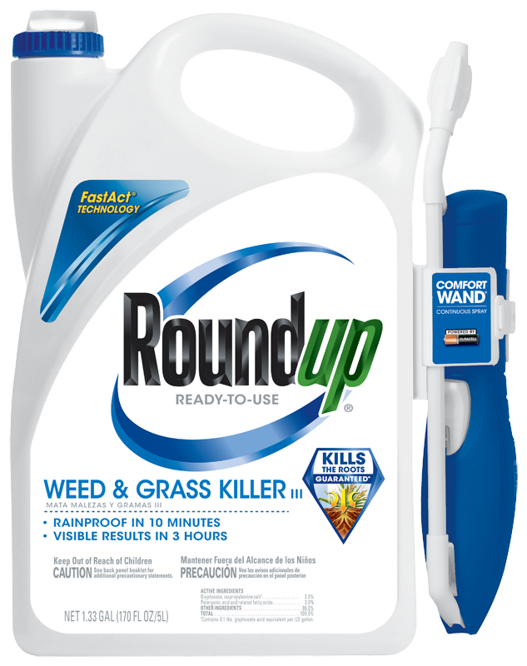
What is glyphosate?
Most heavily used pesticide in history
Monsanto’s Roundup (more than 50% of world supply)
Major uses
  Genetically engineered crops (GMOs)
  Pre-harvest

Slide 6

Rise of pre-harvest glyphosate
Monsanto encourages use on grains, seeds, beans
Benefits: Potentially quicker harvest in wet climate
Costs: significantly higher glyphosate residues in crop, potential crop damage (drift from application)
Pre-harvest Bans: Germany (2014), Austria (2013). Not approved: Finland, France, Greece, Italy, Portugal, Switzerland, & Turkey
Food Co. Leadership: Kellogg investigating suppliers’ pre-harvest use of glyphosate
Wheat:
  Est. 28% of wheat treated with glyphosate in 2015
  3rd largest U.S. crop

Slide 7
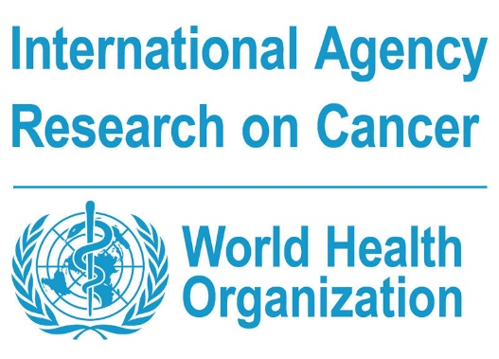
Health Impacts
Classified by IARC as probable carcinogen
Other effects: disruption of endocrine system, other biological processes. Potential impacts on gut bacteria.
“Inert” ingredients in Roundup formulation increase toxicity
  Example: POEA banned in herbicide in EU, no ban in U.S.
Disadvantaged communities face greatest risk

Slide 8
Glyphosate Everywhere
In Human Bodies
  UCSF Study – Present in 93% of 131 individuals tested
  U.S. Allowed Daily Intake: 3x higher than EU, 17x higher than independent scientists recommend¹
In the Environment
  Persists up to 1 year in water and soil
    USGS finds glyphosate residue in 60% of surface waters in Midwest
  Drifts off-target to damage crops, harm communities
  Contributes to Monarch decline by killing milkweed plants in farm fields
¹Antoniou M, Habib MEM, Howard CV, Jennings RC, Leifert C, et al, “Teratogenic Effects of Glyphosate-Based Herbicides: Divergence of Regulatory Decisions from Scientific Evidence,” Journal of Environmental and Analytical Toxicology (2012), doi:10.4172/2161-0525.S4-006

Slide 9
Glyphosate Use and Implications
Dr. Charles Benbrook
Visiting Professor, Newcastle University and Benbrook Consulting Services

Slide 10
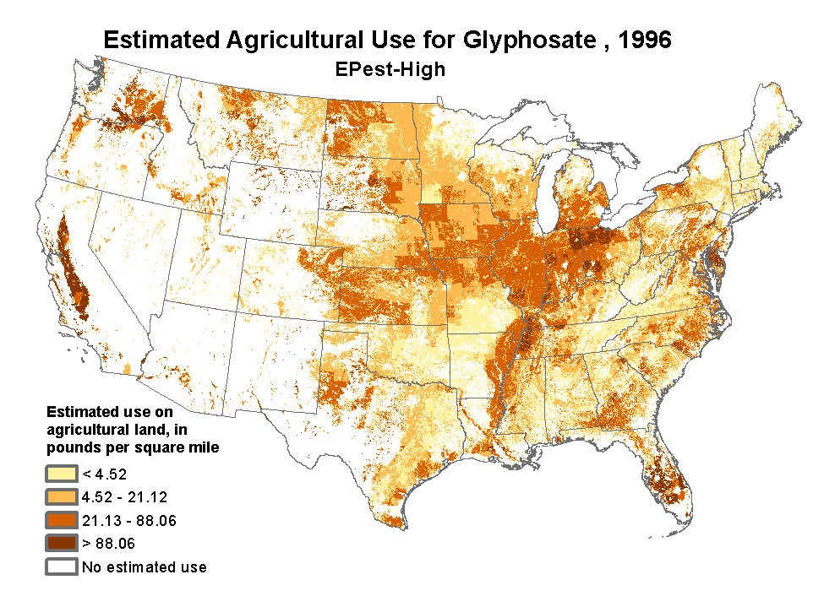
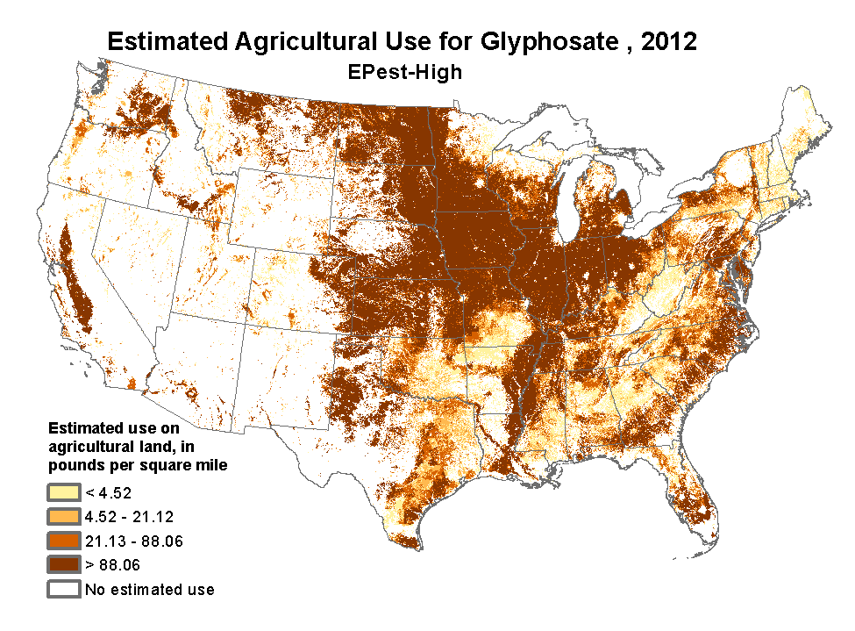

Slide 11
Glyphosate Residues

Slide 12
Creating Superweeds
80-85% global GMOs are herbicide-resistant (HR)
Superweeds
  50% of US farms
  Estimated >120m
  acres infested in 2017

Slide 13
Next Generation of HR Crops
Monsanto
  Roundup Ready Xtend (tolerates both glyphosate and dicamba)
  Dicamba
    Associated with non-Hodgkin lymphoma (NHL)
    Greater volatility & drift damage potential
Dow Chemical
  Enlist Duo (tolerates both glyphosate and 2,4-D)
  2,4-D
    Agent Orange component, IARC “possible carcinogen”, also associated with NHL
    Greater volatility & drift damage potential
Bayer, DuPont, Syngenta & BASF also have new HR crops

Slide 14
Herbicide Use Skyrockets
Glyphosate levels projected to remain high
2,4-D and dicamba projected by companies to increase dramatically

Slide 15
Glyphosate Policy
Bill Freese
Science Policy Analyst
Center for Food Safety

Slide 16
Flaws in Regulation of Glyphosate & GMOs
USDA does not test foods for glyphosate residues, and allows many new GMOs to escape regulation altogether (e.g., CRISPR)
EPA relies primarily on animal studies conducted by industry, discounts human epidemiology & other peer-reviewed literature
EPA ignores co-exposure to additional often toxic ingredients in glyphosate formulations, and to other pesticides

Slide 17
Glyphosate’s Carefully Crafted Image
Monsanto found guilty of false/misleading advertising by NY State AG in 1996 and 1998
  “Practically non-toxic” – based on amount required to kill rats, nothing to do with human risk
  “Biodegrades into natural materials” – persists long enough for substantial human exposure
EPA found glyphosate a “possible carcinogen” in 1985 – reversed only after heavy intervention by Monsanto

Slide 18
Glyphosate and Cancer - Science
WHO’s IARC: “probably carcinogenic to humans”
  World’s leading cancer authority
  Working Group chaired by Aaron Blair, eminent epidemiologist recently retired from U.S. National Cancer Institute
94 leading medical scientists support IARC (Portier et al. 2016)
EPA Scientific Advisory Panel (March 2017):
  EPA failed to follow its own cancer guidelines
  Suggestive evidence of carcinogenicity
  Lymphomas in animals match non-Hodgkin lymphoma in farmers
State of CA: glyphosate carcinogenic under Prop. 65

Slide 19
Glyphosate and Cancer - Politics
Deputy Director of EPA’s Office of Pesticide Programs (Jess Rowlands) was a Monsanto ally:
  Tipped off Monsanto to IARC decision months before release
  Killed a review of glyphosate by NIH agency, reportedly saying: “If I can kill this, I should get a medal”
Monsanto officials suggest “ghostwriting” glyphosate articles for academics; EPA/EU rely on industry summaries of animal cancer studies
EPA removes scientist from Scientific Advisory Panel at behest of CropLife (pesticide industry trade group)

Slide 20
Policy Developments
California’s Office of Environmental Health Hazard Assessment (OEHHA) has listed glyphosate as carcinogenic under Prop. 65
  Court rejected a Monsanto lawsuit against CA seeking to overturn Prop. 65 listing
  OEHHA now determining “safe harbor” level for warning/labeling purposes
EU conditional approval for 18 months

Slide 21
Risks and Recommendations
Austin Wilson
Report Author and Environmental Health Program Manager at As You Sow

Slide 22

Financial Risks of Glyphosate
Legal liability
  Farmers suing, alleging non-Hodgkin lymphoma & that Monsanto covered up risks
  False advertising lawsuits (PepsiCo Quaker Oats, Post Shredded Wheat) over glyphosate in “all-natural”
Reputational Damage
  Petitions, actions
The “pesticides are necessary myth” is debunked

Slide 23
Recommendations
Investors
  Focus on downstream companies: food, restaurant, retail
  Focus on pre-harvest & GE herbicide-resistant crops
  Mandate clear & binding weed resistance prevention plans
  Promote & invest in agro-ecology
  Fruit and vegetable producers: join Equitable Food Initiative

Slide 24
Recommendations
Communities
  Promote Integrated Pest Management (IPM) in cities, business, homes
  Buy products sustainably produced (organic & others)
  Support strong regulations

Slide 25
Questions?
Use the Q&A window to send us your questions

Slide 26

Thank you!
Webinar recording and report: http://go.asyousow.org/RoundupRevealed

